Slide 1

IEEE 802.11 Wireless Networks- Part Two
Main reference: “802.11 Wireless Networks, The Definitive Guide by Matthew Gast Publisher : O'Reilly
  Chapter 1-4, also parts of chapter 7
Extra reference: “IEEE 802.11 Tutorial” By Mustafa Ergen, UC Berkeley, California

Slide 2
Presentation
By April 3rd : Form groups of max 4 and choose the topic.
Each group will have 30 minutes to present their work.
May 8th to May 29th : Presentation days.

Slide 3
Wireless LANs 802.11
802.11 MAC Layer
802.11 Frame Format
Data Flow Examples

Slide 4
802.11 MAC

Slide 5
MAC Functionality
Reliability of data delivery service
Controlled access of shared wireless network
Synchronization Issues
Power Saving Sequences
Frame Types
Notes:
CS 625, IITK CSE
Jan3, 2002
Introduction to wireless communication
* MAC rides directly on the physical layer
Provides framing
Provides inter-operability between different layers and to other 802 LAN networks
Uses CSMA/CA because of higher probability of collision and lower speeds

Slide 6
A. Challenges of MAC
Problems to solve
  Radio Frequency Link Quality: the air is noisy and unreliable medium
  The Hidden Node problem
Solutions : Frame Exchange Protocol
  Every frame is acknowledged (ACK)
  Clear To Send & Request To Send frames
  Fragment long data frames
Notes:
CS 625, IITK CSE
Jan3, 2002
Introduction to wireless communication
* Unlike wired network, a mobile node may not always know about all other mobile node in the same BSS

Slide 7
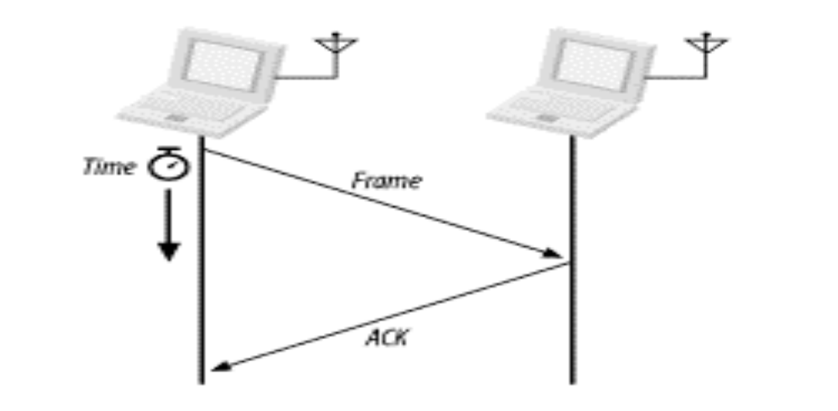
1. Bad RF quality Solution: Acknowledgement (ACK)
Atomic Operation
Traffic flow:
  Data is being sent (Source → Destination)
  If the data was received correctly in the destination, an ACK (Destination → Source) will be sent back. If ACK is
  returned than go to 6.
  Else (data was not received or ACK didn’t returned), increment the retry counter.
  If retry counter < MAX_RETRY_COUNTER go to 1
  Else (counter exceeded) ➔transmit failed (frame is lost)
  Transmission succeeded, continue.
Notes:
CS 625, IITK CSE
Jan3, 2002
Introduction to wireless communication
* 802.11 allows two stations to lock (reserve) the link during the transmission/ACK sequence as we will see in the next 2-3 slides. Hence the sequence appears as an “atomic” operation

Slide 8
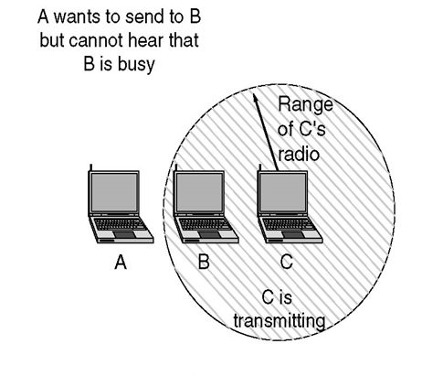
2. Hidden Node Problem
Hidden terminals
  C sends to B, A cannot receive C
  A wants to send to B, A senses a “free” medium (CS fails)
  collision at B, C cannot receive the collision (CD fails)
  C is “hidden” for A

Slide 9
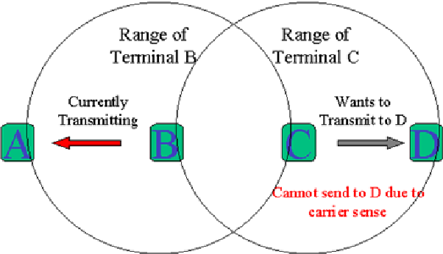
Exposed Station Problem
Exposed terminals
  B sends to A, C wants to send to another terminal D
  C has to wait, CS signals a medium in use
  but A is outside the radio range of C, therefore waiting is not necessary
  C is “exposed” to B

Slide 10


IEEE 802.11: multiple access
avoid collisions: 2⁺ nodes transmitting at same time
802.11: CSMA - sense before transmitting
  don’t collide with ongoing transmission by another node
802.11: no collision detection!
  difficult to receive (sense collisions) when transmitting due to weak received signals (fading)
  can’t sense all collisions in any case: hidden terminal, fading
  goal: avoid collisions: CSMA/C(ollision)A(voidance)
A
B
C
C
A’s signal
strength
C’s signal
strength
B
A
space
Wireless, Mobile Networks

Slide 11
MAC Collision Avoidance
MACA (Multiple Access with Collision Avoidance) uses short signaling packets for collision avoidance
  RTS (request to send): a sender request the right to send from a receiver with a short RTS packet before it sends a data packet
  CTS (clear to send): the receiver grants the right to send as soon as it is ready to receive
Signaling packets contain
  sender address
  receiver address
  packet size
Wireless Networks Spring 2005

Slide 12

MACA examples
MACA avoids the problem of hidden terminals
  A and C want to
  send to B
  A sends RTS first
  C waits after receiving
  CTS from B
MACA avoids the problem of exposed terminals?
  B wants to send to A, C
  to another terminal
  now C does not have
  to wait for it cannot
  receive CTS from A
RTS
RTS
CTS
CTS
CTS
CTS
A
B
C
A
B
C
RTS
RTS
CTS
A
B
C

Slide 13
CSMA/CA
CSMA/CD does not work in wireless channel
  difficult to detect collisions in a radio environment
    Power level varies due to other factors such as fading
  difficult to control the wireless channel
  hidden and exposed terminal problems
CSMA/CA is used in wireless environments
  Sense before transmit
  Contend for channel usage
  “Collision detection” via the acknowledgment
  Time-spacing to set priority
  Avoid collisions via carrier sensing and virtual carrier sensing

Slide 14
B. MAC Access Modes and Timing
Two medium access schemes
Point Coordination Function (PCF)
  For infrastructure mode: Point coordinators reside in access points
  Centralized: Used when contention-free communication is required
  Point coordinators ensure that the medium is provided without contention.
Distributed Coordination Function (DCF)
  For AD HOC mode
  Ethernet-like access CSMA/CA
  Stations use a random Exponential backoff after each frame, may use the CTS/RTS clearing technique to further reduce the possibility of collisions.
Wireless Networks Spring 2005

Slide 15
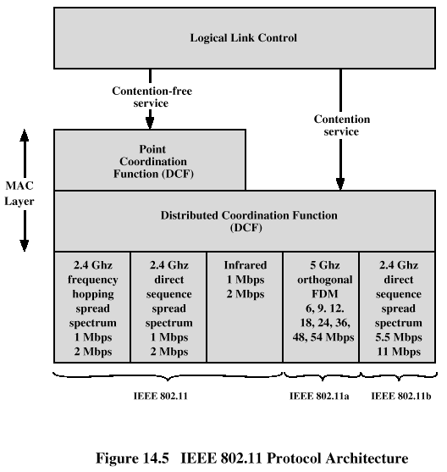
MAC / Physical Layer
Wireless Networks Spring 2005

Slide 16
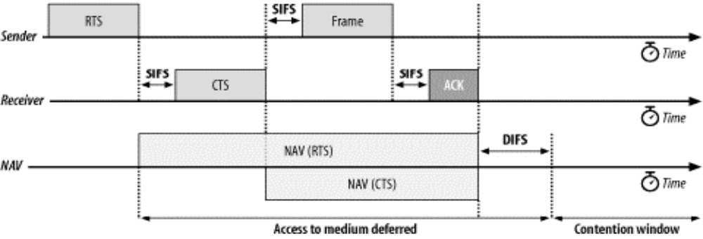
Carrier Sensing functions and Network Allocation Vector NAV
Two types of Carrier Sensing :
  Physical CS (Expensive HW, does not solve hidden nodes)
  Virtual CS (NAV: Network Allocation Vector)
    802.11 frames carry a duration field, used to reserve the medium for a fixed time period.
Transmitter sets NAV in RTS
Receiver sets NAV in CTS
Notes:
CS 625, IITK CSE
Jan3, 2002
Introduction to wireless communication
* Problems with putting Carrier sense functions in the physical layer
Requires more expensive transceivers because requiring the ability to send and receive at the same time is expensive
Even it it exists in the RF circuitry, it does not solve the hidden node problem

Slide 17
NAV: Network Allocation Vector
Idea: Most 802.11 frames carry a duration field, used to reserve the medium for a fixed time period
Station sets NAV field to the duration it will reserve the medium
  Including RTS/CTS and inter-frame spacing
The NAV is carried in the frame headers on the RTS and CTS
Every station must remember the NAV value in the last frame
Notes:
Explanation
Problem: even all nodes can do physical layer carrier sense, due to hidden node problem, nodes that can only hear the sender cannot hear the receiver and nodes that can hear he receiver cannot hear the sender
Hence the sender MUST tell the the nodes around it how long to wait and the receiver tells all the nodes around it how long to wait
In the RTS, the sender sets the NAV field to the duration other nodes have to remain silent
This duration:
The duration starts at the end of the RTS
The duration includes all activities
The SIFS between the RTS frame and the CTS frame
The duration of the CTS frame
The SIFS between the CTS frame and the data frame
The duration of the data frame
The SIFS between the data frame and the ACK
The duration of the ACK frame
The SIFS between the end of the ACK frame and the next contention period
Similarly, when the receiver sends the CTS, it has to include the above durations but does not include the SIFT between the RTS and the CTS and the CTS itself. Hence the duration in the NAV field in the CTS frame contains all durations starting from the end of the CTS

Slide 18
RTS/CTS with NAV
Sending unicast packets
  station can send RTS with reservation parameter after waiting for DIFS (reservation determines amount of time the data packet needs the medium)
  ack via CTS after SIFS by receiver (if ready to receive)
  sender can now send data at once, acknowledgement via ACK
  other stations store reservations distributed via RTS and CTS
DIFS
RTS
data
sender
SIFS
SIFS
SIFS
CTS
ACK
receiver
NAV (RTS)
DIFS
other
stations
data
NAV (CTS)
t
defer access
contention
SIFS is the interframe spacing prior to transmission of an acknowledgment
Distributed Interframe Space (DIFS) = SIFS + (2 * Slot time)

Slide 19
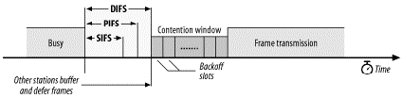
Interframe Spacing
Short interframe space (SIFS)
  The SIFS is used for the highest-priority transmissions, such as RTS/CTS frames and positive acknowledgments.
PCF interframe space (PIFS)
  used by the PCF during contention-free operation.
  Stations with data to transmit in the contention-free period can transmit after the PIFS has elapsed and preempt any contention-based traffic.
DCF interframe space (DIFS)
  minimum medium idle time for contention-based services.
Extended interframe space (EIFS)
  No fixed value,
  is used only when there is an error in frame transmission.
Notes:
CS 625, IITK CSE
Jan3, 2002
Introduction to wireless communication
PCF: Remember it is Point Co-ordination function. It is the functionality that allows a central co-rdinator to coordinate among different nodes in the same BSS
DCF: Distributed Coordination Function. It the functionality of coordinating medium access in a decentralized fashion. Basically, it is what we studied in the previous few slides

Slide 20
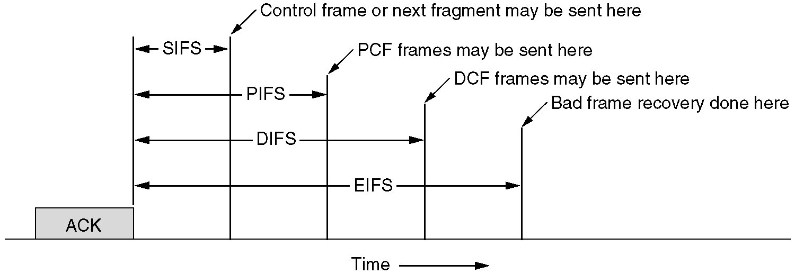
Interframe spacing in 802.11
Normal Frame Transmission
  A station needs to wait for DIFS before it starts sending
  However, once it starts sending, the entire operation from RTS till the reception of ACK needs to atomic
  Hence all operations after RTS use SIFS

Slide 21
Priorities in 802.11 MAC Layer
Priorities
  defined through different inter frame spaces
  SIFS (Short Inter Frame Spacing)
    highest priority, for ACK, CTS, polling response
  PIFS (PCF IFS)
    medium priority, for time-bounded service using PCF
  DIFS (DCF, Distributed Coordination Function IFS)
    lowest priority, for asynchronous data service
DIFS
DIFS
PIFS
medium busy
SIFS
contention
next frame
t
direct access if
medium is free ≥ DIFS

Slide 22
C. Contention-Based Access using DCF
Two basic rules apply to all transmissions using the DCF:
If the medium has been IDLE for longer than the DIFS, transmission can begin immediately. Carrier Sensing is done with Physical and Virtual(NAV) method
  If the previous frame was received without errors, the medium must be free for at least the DIFS.
  If the previous transmission contained errors, the medium must be free for the amount of the EIFS.
If the medium is BUSY, the station must wait for the channel to become idle. 802.11 refers to the wait as access deferral. If access is deferred, the station waits for the medium to become idle for the DIFS and prepares for the exponential backoff procedure.
Notes:
CS 625, IITK CSE
Jan3, 2002
Introduction to wireless communication

Slide 23
D. Error Recovery in Contention-Based DCF
Error in Contention-Based DCF is due to:
  Failure to acquire the medium because the medium was not idle for at least DIFS
  2. Failure to receive an ACK
    i.e. Atomic exchanges must complete in their entirety to be successful
Contention Window mechansim also known as “backoff window”
Notes:
CS 625, IITK CSE
Jan3, 2002
Introduction to wireless communication

Slide 24
D. Contention Window Mechanism
  Contention Window also known as “backoff window”: is the time period where stations are allowed to start an Atomic Frame Exchange sequence
Contention Window starts with DIFS after the last successful atomic frame exchange period
Every time an error occurs, the contention window is doubled
  Hence reducing the probability of error AND
  Spreading competing stations more widely
    I.e. Giving each station less time because there are more competing stations
Notes:
CS 625, IITK CSE
Jan3, 2002
Introduction to wireless communication

Slide 25
Contention Window Mechanism
Contention Window is divided into slots, Slot length medium-dependent;
  Higher-speed physical layers use shorter slot times.
Stations pick a random slot within the Contention Window
  i.e. Station with smallest number wins
If Stations wants to or attempts to send and there is an error
  Binary Exponential Backoff starts and Contention Window is doubled

Slide 26
CSMA/CA with Contention Window
contention window
(randomized back-off
mechanism)
DIFS
DIFS
medium busy
next frame
direct access if
medium is free ≥ DIFS
t
slot time
Station ready to send starts sensing the medium (Carrier Sense based on CCA, Clear Channel Assessment)
If the medium is free for the duration of an Inter-Frame Space (IFS), the station can start sending (IFS depends on service type)
If the medium is busy, the station has to wait for a free IFS, then the station must additionally wait a random back-off time (collision avoidance, multiple of slot-time)
If another station occupies the medium during the back-off time of the station, the back-off timer pauses (fairness)
Notes:
12

Slide 27
802.11 access scheme details
Sending unicast packets
  station has to wait for DIFS before sending data
  receivers acknowledge at once (after waiting for SIFS) if the packet was received correctly (CRC)
  automatic retransmission of data packets in case of transmission errors
DIFS
data
sender
SIFS
ACK
receiver
DIFS
other
stations
data
t
waiting time
contention

Slide 28
Contention Window Mechanism
Used by most traffic
Ethernet-like contention mechanism – no central control
Used by Infrastructure/IBSS networks
Before attempting to transmit,
  station checks whether the medium is idle.
    If the medium is not idle, stations defer and employ a BEB algorithm to avoid collisions.
contention
window
DIFS
Busy medium
Next Frame
slot time
Defer access
BEB: Binary Exponential Backoff
Notes:
CS 625, IITK CSE
Jan3, 2002
Introduction to wireless communication

Slide 29
Binary Exponential Backoff
Sense before transmit: Choose a random number over the interval [0, CW]
Backoff Time = Random() × aSlotTime
  Random() = Pseudo-random integer drawn from a uniform distribution over the interval [0,CW],
  CW is an integer within the range of values of CWmin and CWmax,
  SlotTime = The value of the aSlotTime correspondingly named PHY characteristic.
  The set of CW values shall be sequentially ascending integer powers of 2 minus 1
CW = Contention Window

Slide 30
Binary Exponential Backoff
If the medium is idle for a backoff slot, the backoff time is decremented by aSlotTime
If the medium is determined to be busy during a backoff slot, the backoff procedure is suspended until the medium is determined to be idle for DIFS period
Whenever the Backoff Timer reaches zero, a packet transmission begins
Whenever the transmission is not successful (due to channel conditions or collisions via acknowledgment or timeout), the contention window size doubles and backoff timer is regenerated
Notes:
CS 625, IITK CSE
Jan3, 2002
Introduction to wireless communication

Slide 31
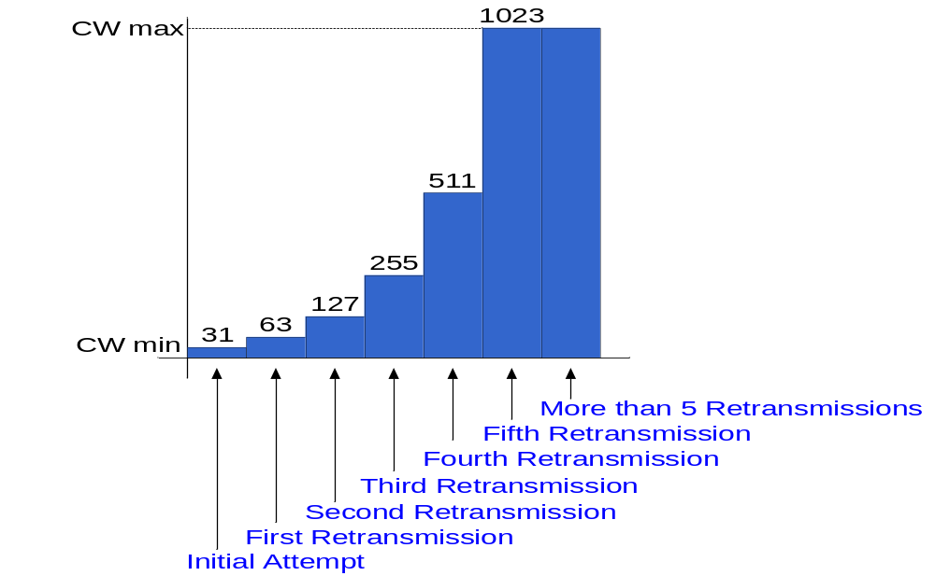
Contention Window Binary Exponential Increase
For DSSS PHY
Slot time = 20 μs

Slide 32
Transmission with RTS-CTS + BEB
DIFS
Request to send
DATA
Transmitter
RTS
DATA
A
SIFS
SIFS
SIFS
Backoff
Receiver
CTS
Clear to send
ACK
Acknowledgement
B
DIFS
…
ACK
NAV(RTS)
RTS
…
Others
NAV(CTS)
Backoff

Slide 33
Two stations BEB Example
Two Stations B1, B2, Contention Window = 31
B1 = 25
B1 = 5
wait
data
data
wait
B2 = 20
B2 = 15
B2 = 10
B1 and B2 are backoff intervals at nodes 1 and 2
Notes:
CS 625, IITK CSE
Jan3, 2002
Introduction to wireless communication

Slide 34
Contending stations
DIFS
DIFS
DIFS
DIFS
bo_{e}
bo_{r}
bo_{e}
bo_{r}
bo_{e}
busy
station₁
bo_{e}
busy
station₂
busy
station₃
bo_{e}
busy
bo_{e}
bo_{r}
station₄
bo_{e}
bo_{r}
bo_{e}
busy
bo_{e}
bo_{r}
station₅
t
busy
medium not idle (frame, ack etc.)
bo_{e}
elapsed backoff time
packet arrival at MAC
bo_{r}
residual backoff time

Slide 35
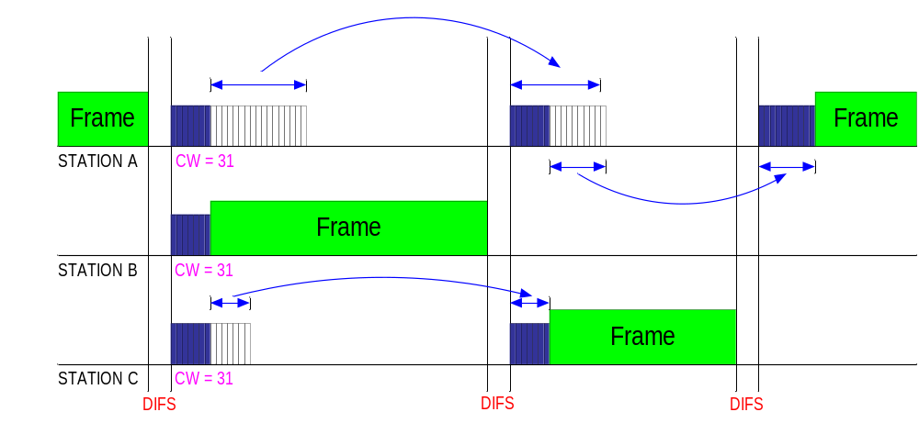
CSMA/CA
DCF mode operation

Slide 36
CSMA/CA with Exponential Backoff
Begin
Busy?
No
Transmit frame
Yes
Max window?
No
Double window
Wait inter-frame period
Yes
Max attempt?
Yes
Discard packet
Increment attempt
Wait U[0,W]
No
Increment attempt

Slide 37
Fairness Issues in BEB
Assume that initially, A and B both choose a backoff interval in range [0,31] but their RTSs collide
Nodes A and B then choose from range [0,63]
  Node A chooses 4th slots and B choose 60th slots
  After A transmits a packet, it next chooses from range [0,31]
  It is possible that A may transmit several packets before B transmits its first packet
Common problem:
  BEB favors the last successful station*
Notes:
CS 625, IITK CSE
Jan3, 2002
Introduction to wireless communication
*The station that won during the last contention window competes with all other stations with the same probability
One might think that the station that won in the last CW should not compete with the same probability as the others for the next few CWs
e.g. its random number should be within a larger

Slide 38
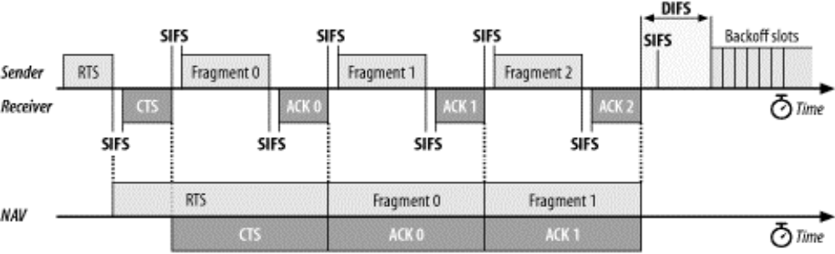
E. Fragmentation and Reassembly
More reliable transmission
Fragments all have the same frame sequence number but have ascending fragment numbers to aid in reassembly.
Frame control information indicates whether more fragments are coming.
Notes:
CS 625, IITK CSE
Jan3, 2002
Introduction to wireless communication
Explanation: How fragmentation works with NAV
- The RTS sets the NAV to the period of the first fragment plus SIFS plus ACK of the first fragment
After receiving the first ACK, sender and receiver know that the fist fragment has been successful and that the sender has acquired the channel
For the rest of fragments, the sender sends each fragment SIFS after the other
Because the sender has already taken the channel and uses SIFS for the rest of the fragments, it is guaranteed that no other station attempts to use the channel

Slide 39
Fragmentation
DIFS
RTS
frag₁
frag₂
sender
SIFS
SIFS
SIFS
SIFS
SIFS
CTS
ACK₁
ACK₂
receiver
NAV (RTS)
NAV (CTS)
NAV (frag₁)
DIFS
other
stations
data
NAV (ACK₁)
t
contention

Slide 40
802.11 FRAME FORMAT

Slide 41
802.11 - Frame format
Types
  control frames, management frames, data frames
Sequence numbers
  important against duplicated frames due to lost ACKs
Addresses
  receiver, transmitter (physical), BSS identifier, sender (logical)
Miscellaneous
  sending time, checksum, frame control, data
bytes
2
2
6
6
6
2
6
0-2312
4
Frame
Control
Duration
ID
Address
1
Address
2
Address
3
Sequence
Control
Address
4
Data
CRC
Version, Type, Subtype, To DS, From DS, More Fragments, Retry,
Power Management, More Data, Wired Equivalent Privacy (WEP), and Order
Notes:
There are three frame types: control (e.g., RTS/CTS/Ack), data, and management (e.g., association). Each of the frame types have several defined subtypes.
Sequence control: fragment number, sequence number (remains constant for the same frame/fragment)

Slide 42
802.11 frame: addressing
2
2
6
6
6
2
6
0 - 2312
4
frame
control
duration
address
1
address
2
address
3
seq
control
address
4
payload
CRC
Address 4: used only in ad hoc mode
Address 1: MAC address
of wireless host or AP
to receive this frame
Address 3: MAC address
of router interface to which AP is attached
Address 2: MAC address
of wireless host or AP
transmitting this frame
Follows the conventions used for the other IEEE 802 networks → 48 bits long MAC Address
If the first bit (0) → Unicast, (1) → Mulitcast , All bits are 1s → Broadcast

Slide 43
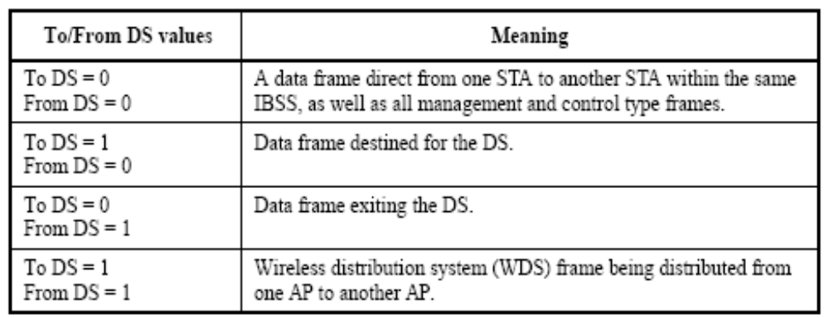
To DS & From DS bits (AP)
DS: Distribution System. I.e. infrastructure BSS and packet is to or from the AP or the backbone between APs
Notes:
CS 625, IITK CSE
Jan3, 2002
Introduction to wireless communication

Slide 44
To/From DS bit
To DS bit is set – Frame is coming from a wireless station to the wired network
From DS bit is set – Frame is coming from the wired network, or possibly the AP itself and is destined for a wireless station
From DS and To DS are cleared – Frame is from an Ad-hoc network or not leaving the wireless env.
From DS and To DS are set – Frame coming from a WDS network. Example: wireless link between buildings

Slide 45
802.11 frame: addressing
To DS / From DS: 1 / 0
Internet
H1
R1
router
AP
R1 MAC addr H1 MAC addr
dest. address
source address
802.3 frame
AP MAC addr H1 MAC addr R1 MAC addr
address 1
address 2
address 3
802.11 frame

Slide 46
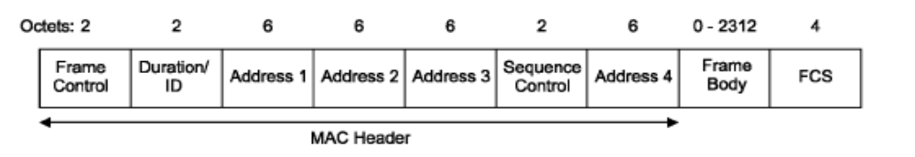
Frame Format
The MAC frame consists of:
  MAC header
    Frame Control
    Duration
    Address → not all 4 are always used
    Sequence Control information
  Frame body
  FCS →32-bit CRC
Notes:
CS 625, IITK CSE
Jan3, 2002
Introduction to wireless communication

Slide 47
802.11 frame: Frame Control
duration of reserved
transmission time (RTS/CTS)
frame seq #
2
2
6
6
6
2
6
0 - 2312
4
frame
control
duration
address
1
address
2
address
3
seq
control
address
4
payload
CRC
2
2
4
1
1
1
1
1
1
1
1
Protocol
version
Type
Subtype
To
AP
From
AP
More
frag
Retry
Power
mgt
More
data
WEP
Rsvd
frame type
(RTS, CTS, ACK, data)
Protocol version: is currently 0 and all other values are reserved for future use
More Frag: indicate whether there is another frag to follow (1) or not (0). (Same as IPv4)
Retry: indicate whether this is a first (0) or retransmission (1). Helps receiver eliminate duplicate
Pwr Mgt: Used by MN to indicate power saving mode after completion of current Tx: 0: remain active ,1: PS
More Data: AP indicates to PS STA that more frames are buffered for this STA
WEP: (1) → WEP is used
Order: Frames and fragments can be transmitted in order at the cost of additional processing by both the sending and receiving MACs. When the "strict ordering" delivery is employed, this bit is set to 1.

Slide 48
Frame Types
Data frames: are the pack horses of 802.11, hauling data from station to station.
Control frames: are used in conjunction with data frames to perform:
  area clearing operations
  channel acquisition and
  carrier-sensing maintenance functions, and
  positive acknowledgment of received data.
Management frames: perform supervisory functions; they are used to:
  join and leave wireless networks and
  move associations from AP to AP.
Notes:
CS 625, IITK CSE
Jan3, 2002
Introduction to wireless communication

Slide 49
802.11 MAC management
Synchronization
  try to find a LAN, try to stay within a LAN
  timer etc.
Power management
  sleep-mode without missing a message
  periodic sleep, frame buffering, traffic measurements
Association/Re-association
  integration into a LAN
  roaming, i.e. change networks by changing access points
  scanning, i.e. active search for a network
MIB - Management Information Base
  managing, read, write
Notes:
Each STA shall maintain a TSF timer with modulus 2 64 counting in increments of microseconds. STAs expect to receive beacons at a nominal rate. The interval between beacons is deÞned by the aBeaconPeriod parameter of the STA. A STA sending a beacon shall set the value of the beaconÕs timestamp so that it equals the value of the STAÕs TSF timer at the time that the Þrst bit of the timestamp is transmitted to the PHY plus the transmitting STAs delays through its local PHY from the MAC-PHY interface to its interface with the wireless medium (antenna, LED emission surface, etc.). The algorithms in this clause deÞne a mechanism that maintains the synchronization of the TSF timers in a BSS to within 4 µs plus the maximum propagation delay of the PHY for PHYs of 1 Mb/s, or greater.

Slide 50
802.11 Management Frames
Enable wireless clients to establish and maintain wireless 802.11 communications:
  Beacon
  Probe request
  Probe response
  Authentication
  De-Authentication
  Association Request
  Association Response
  Di-association
  Re-assocaition request
  Re-association response

Slide 51
Synchronization
Timing Synchronization Function (TSF)
  Enables synchronous waking/sleeping
  Enables switching from DCF to PCF
  Enables frequency hopping in FHSS PHY
    Transmitter and receiver has identical dwell interval at each center frequency
Achieving TSF
  All stations maintain a local timer.
  AP periodically broadcasts beacons containing timestamps, management info, roaming info, etc.
    Not necessary to hear every beacon
  Beacon synchronizes entire BSS
    Applicable in infrastructure mode ONLY
  Distributed TSF (for Independent BSS) more difficult

Slide 52
Infrastructure Mode
One node is designated as Access Point (AP)
AP puts its TSF counter in the beacon frame and sends it out every beacon period (normally 100 msec)
All other nodes in the network update its clock based on the TSF counter of AP
No big problem; only one commander !

Slide 53
Synchronization (infrastructure)
beacon interval
B
B
B
B
Access
point
busy
busy
busy
busy
medium
t
value of the timestamp
B
beacon frame

Slide 54
Synchronization -Beacons
The AP will send a Beacon to notify the station that it has buffered frames to that station.
The station don’t have to wakeup every Beacon (in the IBSS the station MUST wakeup in Beacon receive)
When the station wakes up it sends power save poll (PS-POLL) frame to the AP. The AP then will send to the station its buffered frames.
Notes:
CS 625, IITK CSE
Jan3, 2002
Introduction to wireless communication

Slide 55
Adhoc Network
No AP; each node competes for beacon transmission every beacon period
In the beginning of a beacon period
  Calculate a random backoff delay
  If the delay timer expires, send out a beacon attached with its local TSF counter
Upon receiving a beacon
  Cancel the pending beacon if any
  Update its local TSF counter if the frame contains larger counter value (hardware)

Slide 56
Power management
Idea: switch the transceiver off if not needed
States of a station: sleep and awake
Timing Synchronization Function (TSF)
  stations wake up at the same time
Infrastructure
  AP transmit a Traffic Indication Map (TIM) with its BEACON frame
    list of unicast destinations of buffered data
  AP maintains a Delivery Traffic Indication Map (DTIM) interval
    To send broadcast/multicast frames
Ad-hoc
  Ad-hoc Traffic Indication Map (ATIM)
    announcement of receivers by stations buffering frames
    more complicated - no central AP
    collision of ATIMs possible

Slide 57
802.11 power management
Station-to-AP: “I am going to sleep until next beacon frame”
  AP knows not to transmit frames to this station
  Station wakes up before next beacon frame
Beacon frame: contains list of stations with packets waiting in AP buffer
  station stays awake as long as AP has frames to send it; otherwise sleeps again until next beacon frame
  if AP has packets for it, station polls AP (PS_POLL)
Broadcast packets can also be buffered

Slide 58
Power saving (infrastructure)
TIM interval
DTIM interval
D
B
T
T
d
D
B
access
point
busy
busy
busy
busy
medium
p
d
station
t
T
TIM
D
DTIM
awake
B
p
d
data transmission
to/from the station
broadcast/multicast
PS poll
Notes:
PS poll: Power Save poll

Slide 59
802.11 - Roaming
No or bad connection?
Scanning
  STA scan the environment, i.e., listen into the medium for beacon signals (passive) or send probes (active) into the medium and wait for an answer - Probe Req/RSP
Reassociation Request
  station sends a request to one or several AP(s)
Reassociation Response
  success: AP has answered, station can now participate
  failure: continue scanning
AP accepts Reassociation Request
  signal the new station to the distribution system
  the distribution system updates its data base (i.e., location information)
  typically, the distribution system now informs the old AP so it can release resources
Notes:
Active scanning vs. Passive scanning

Slide 60
DATA FLOW EXAMPLES

Slide 61
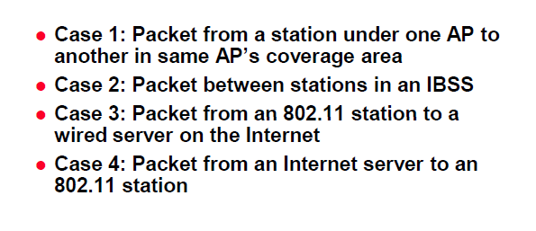
Data Flow Examples
Notes:
CS 625, IITK CSE
Jan3, 2002
Introduction to wireless communication

Slide 62
To DS & From DS bits (AP)
"To DS": Set to 1 in all data frames sent from STA to AP.
"From DS": Set to 1 in call data frames sent from AP to STA.
Both "To DS" and "From DS" may be set to 1 if the frame is being relayed between APs.
DS: Distribution System. I.e. infrastructure BSS and packet is to or from the AP or the backbone between APs
Notes:
CS 625, IITK CSE
Jan3, 2002
Introduction to wireless communication

Slide 63
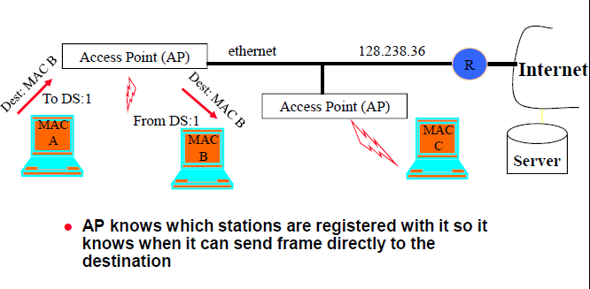
Case 1: Communication Inside BSS
Notes:
CS 625, IITK CSE
Jan3, 2002
Introduction to wireless communication

Slide 64
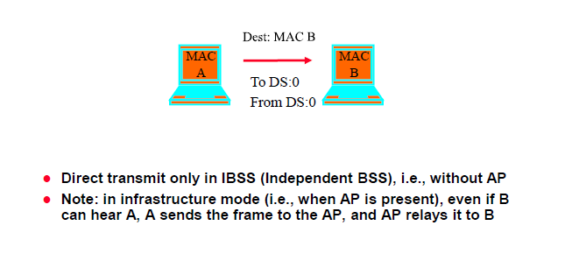
Case 2: Ad Hoc
Notes:
CS 625, IITK CSE
Jan3, 2002
Introduction to wireless communication

Slide 65
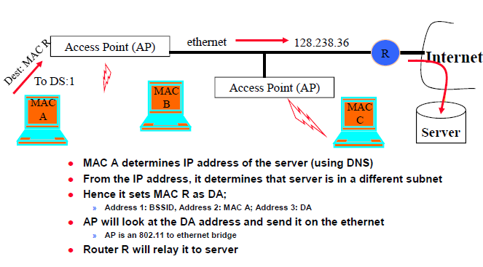
Case 3: To the Internet
NOTE: “R” must be on the same bridged ethernet network as the AP
Notes:
CS 625, IITK CSE
Jan3, 2002
Introduction to wireless communication

Slide 66
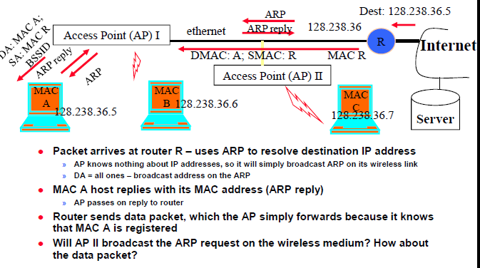
Case 4: From Internet To Station
NOTE: “R” must be on the same bridged ethernet network as the AP
Notes:
CS 625, IITK CSE
Jan3, 2002
Introduction to wireless communication

Slide 67


Slide 68
EXTRA ….

Slide 69
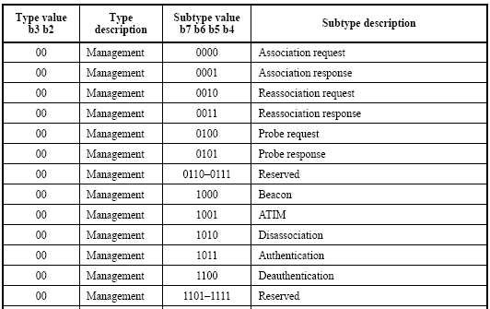
Type and Subtype
3 Frame Types: control, data, and management.
Each type have several defined subtypes.
Management Frame: Type bits (b3,b2) = 00
Notes:
CS 625, IITK CSE
Jan3, 2002
Introduction to wireless communication

Slide 70
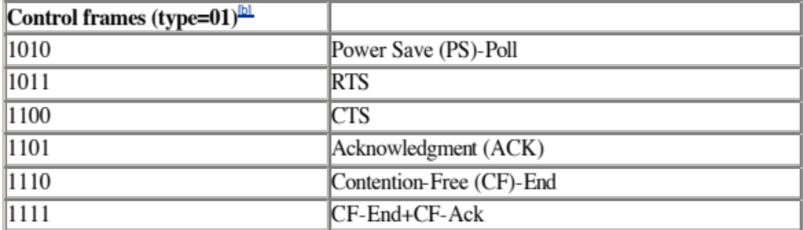
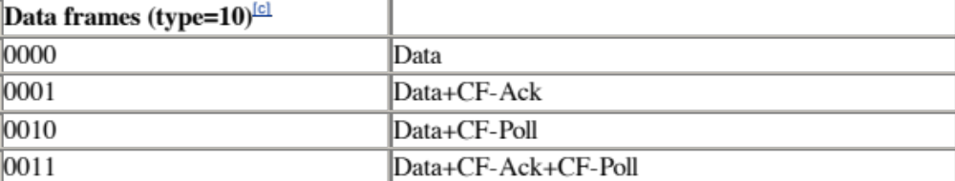
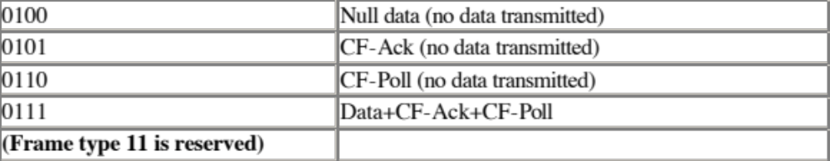
Type and Subtype
CF: Contention Free Used with PCF
Very rarely used or implemented
Skipped, see chapter 8

Slide 71
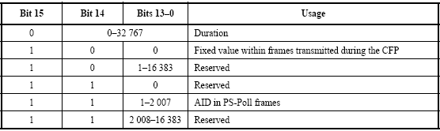
Frame Format → Duration/ID
Power Saving (PS) Poll Frame
  Periodically PS STA send Poll frame to AP to retrieve buffered packets in the AP.
  Poll frame includes the AID: (Association ID)
  AID : Access point ID: AP assigns it to STA during Association to indicate BSS
Contention Free operation : Duration is fixed = 32767 → maximum value
Contention operation : Depends on the length of the frame → NAV in uSeconds**
  All stations must monitor the headers of all frames they receive and update the NAV accordingly.
Notes:
CS 625, IITK CSE
Jan3, 2002
Introduction to wireless communication
CFP: Contention Free Period
CF is used with PCF
Since PCF is very rarely used or implemented, it is NOT covered. See Chapter 8 in book
** See description of “Duration” field in RTS in section 4.2.2

Slide 72
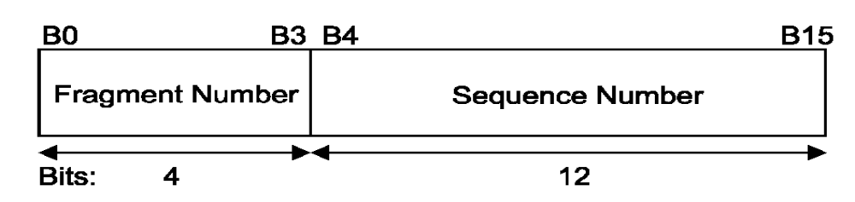
Frame Format → Sequence Control
12bits→ Sequence number is circular modulo 4096
Because each frame must usually* be successfully ACKed before the subsequent frame is retransmitted, it is highly unlikely that a duplicate frame is mistaken for a new one
Higher-level frames are each given a serial number (SN) as they are passed to the MAC for transmission.
All fragments will have the same SN.
Retransmitted frames have the same SN.
The first fragment is given a fragment number of 0. Each successive fragment increments the fragment number by one.
Notes:
CS 625, IITK CSE
Jan3, 2002
Introduction to wireless communication
* If “order” bit in the frame control bit is zero, then packet ordering is not guaranteed

Slide 73
Frame Format → Frame Body & FCS
Frame body:
  Max payload : 2,304 bytes of higher-level data.
  WEP overhead : 8 octets
FCS:
  32-bit CRC
  All fields in the MAC header and the body of the frame are included in the FCS.
Notes:
CS 625, IITK CSE
Jan3, 2002
Introduction to wireless communication

Slide 74
To DS & From DS bits (AP)
DS: Distribution System. I.e. infrastructure BSS and packet is to or from the AP or the backbone between APs
Notes:
CS 625, IITK CSE
Jan3, 2002
Introduction to wireless communication

Slide 75
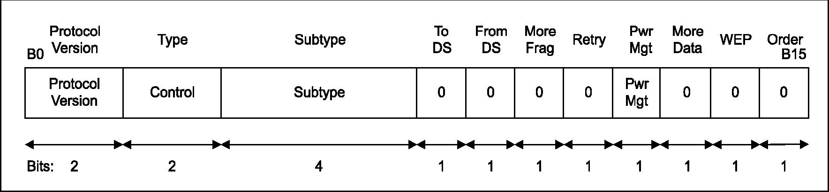
Control Frames
Frame format is dependent on subtype
The subfields within the Frame Control field of control frames are set as illustrated
Notes:
CS 625, IITK CSE
Jan3, 2002
Introduction to wireless communication

Slide 76
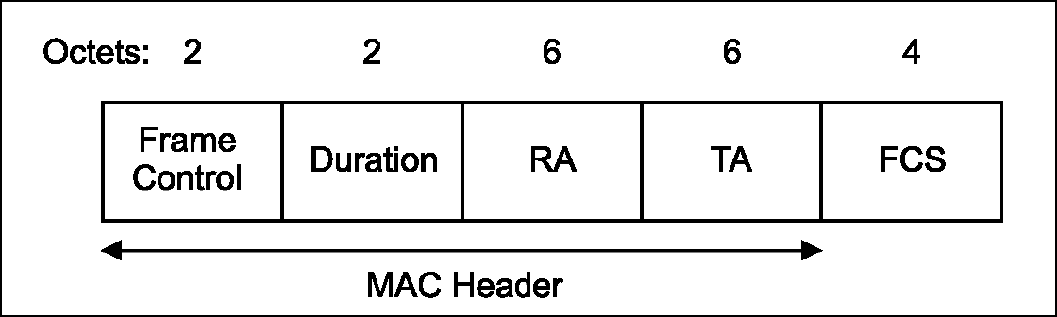
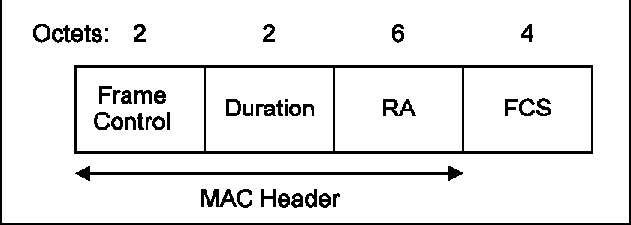
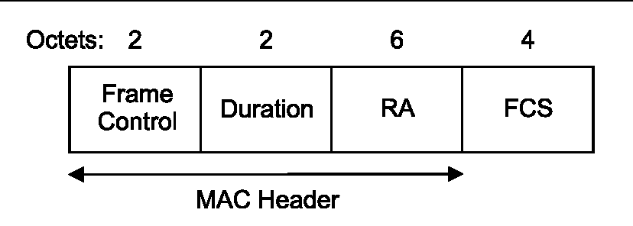
Control Frames → RTS/CTS/ACK Frame
RTS
CTS
ACK
Notes:
CS 625, IITK CSE
Jan3, 2002
Introduction to wireless communication

Slide 77
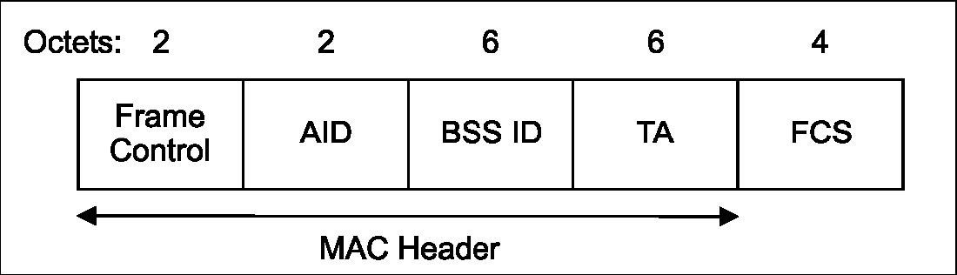
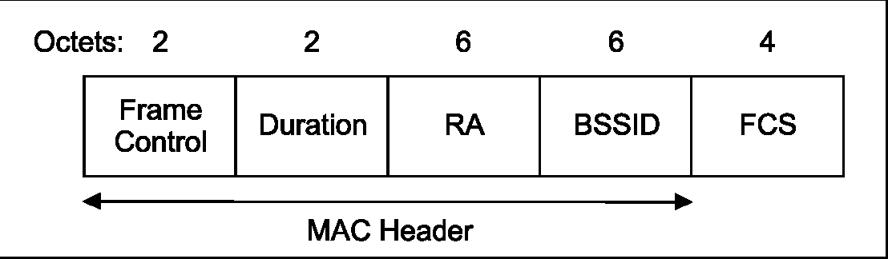
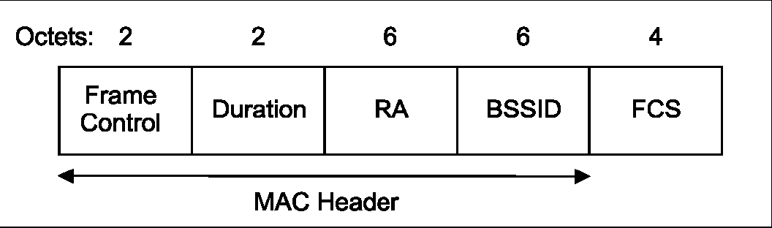
Control Frames → PS-Poll, CF*-End & CF-End+CF-Ack
PS-Poll
CF-End
CF-End+
CF-Ack
Notes:
CS 625, IITK CSE
Jan3, 2002
Introduction to wireless communication
* CF: Contention Free. Used in PCF. Skipped because rarely used and implemented. See chapter 8

Slide 78
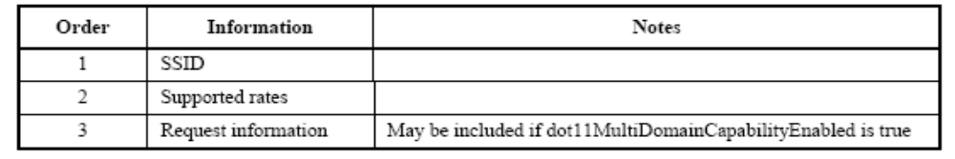
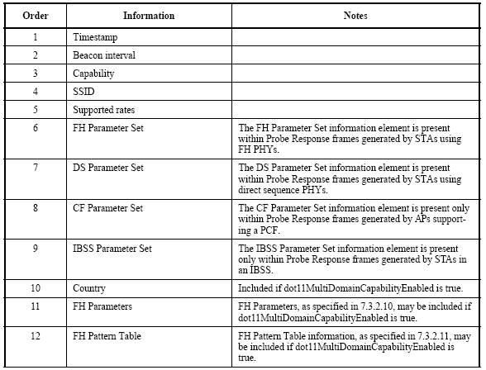
Management Frames → Probe Req/RSP
Probe Req
Probe Rsp
Notes:
CS 625, IITK CSE
Jan3, 2002
Introduction to wireless communication

Slide 79
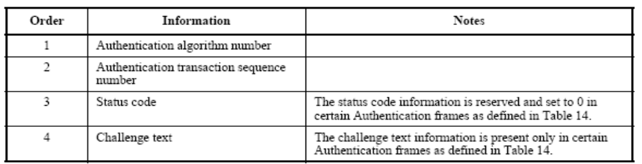

Management Frames → Auth Req/Deauth
Authentication Request frame body
Deauthentication frame body
Notes:
CS 625, IITK CSE
Jan3, 2002
Introduction to wireless communication

Slide 80
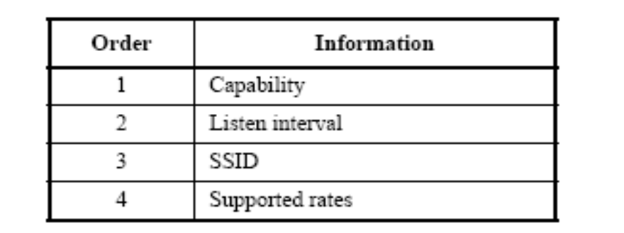
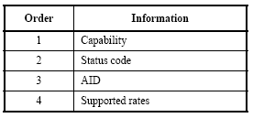
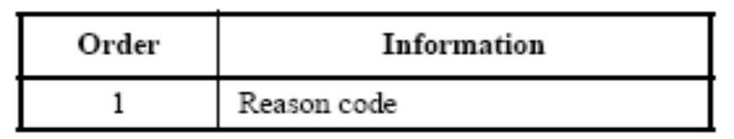
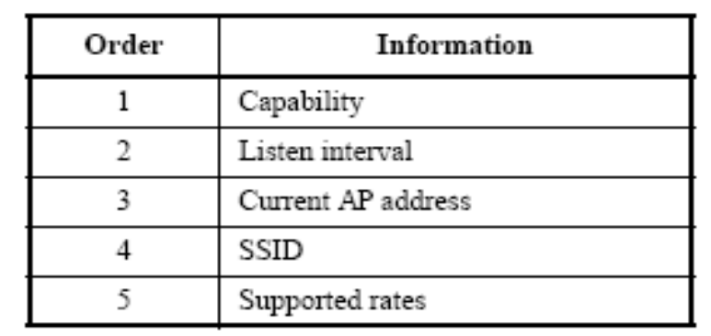
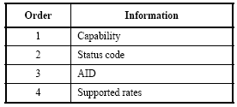
Management Frames → Assoc/Disass
Association Req frame body
Association Rsp frame body
Disassociation frame body
Reassociation Req frame body
Reassociation Rsp frame body
Notes:
CS 625, IITK CSE
Jan3, 2002
Introduction to wireless communication

Slide 81
Wireless network taxonomy
single hop
multiple hops
host connects to
base station (WiFi,
WiMAX, cellular)
which connects to
larger Internet
host may have to
relay through several
wireless nodes to
connect to larger
Internet: mesh net
infrastructure
(e.g., APs)
no base station, no
connection to larger
Internet. May have to
relay to reach other
a given wireless node
MANET, VANET
no
infrastructure
no base station, no
connection to larger
Internet (Bluetooth,
ad hoc nets)

